Slide 1
M2W3: Statistical Learning – Hypothesis Testing
Agenda:
Sampling Distribution & CLT
Confidence Intervals (CI)
Hypothesis Formulation, Null vs Alternative, Type I, II Errors
Hypothesis Testing
One tailed v/s two tailed test
Test of mean
Test of proportion
Test of variance
One way ANOVA
Case studies – Tech Crunch Dataset, Dogs as Pets, Forest Acorns, Medical Insurance, Factory Emissions
Q&A

Slide 2
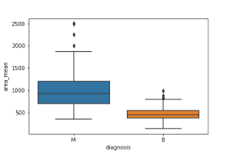
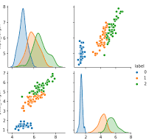
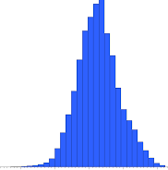
Applied Stats Week 3
Parameter 1
Parameter 2
….
Hypothesis
Population
This session: Basic insights thru
Hypothesis Testing
Predictions
Inferential Statistics
(Probability models,
Hypothesis testing
Regression & Correlation Analysis)
Inference
Generalization
Sampling
of
Population
3Ms – Mean, Median, Mode
Sample (s)
5-Number
Summary
Statistic 1
Statistic 2
……
Distribution
Central Tendency
Variation
Variance
Std. Dev
Descriptive Statistics

Slide 3
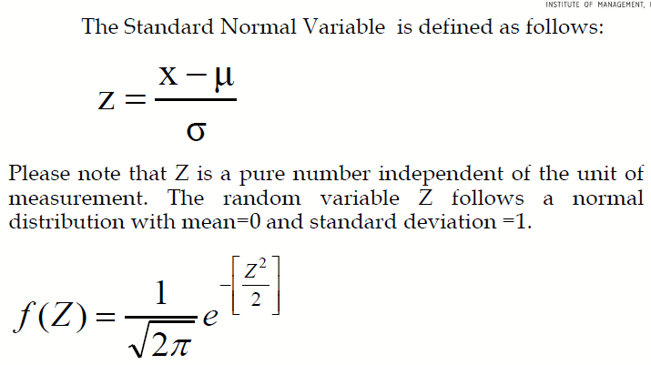
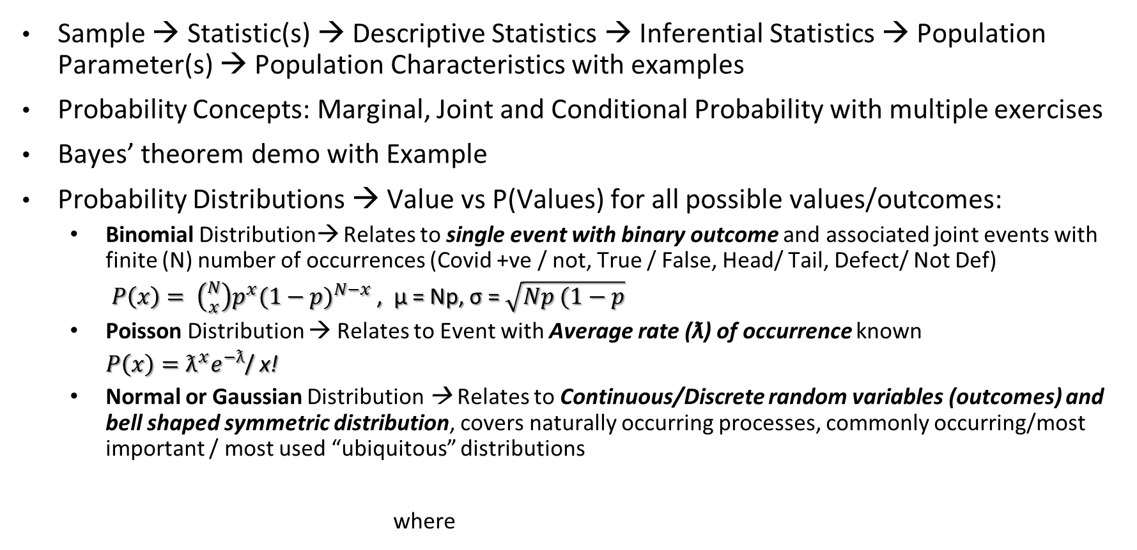
Recap of Week 2 App Stats
Sample → Statistic(s) → Descriptive Statistics → Inferential Statistics → Population Parameter(s) → Population Characteristics with examples
Probability Concepts: Marginal, Joint and Conditional Probability with multiple exercises
Bayes’ theorem demo with Example
Probability Distributions → Value vs P(Values) for all possible values/outcomes:
Binomial Distribution→ Relates to single event with binary outcome and associated joint events with finite (N) number of occurrences (Covid +ve / not, True / False, Head/ Tail, Defect/ Not Def)
$P\left(x\right)= \left({N \atop x}\right)p^{x}{(1−p)}^{N−x}$ , μ = Np, σ = $\sqrt{Np (1−p}$
Poisson Distribution → Relates to Event with Average rate (ƛ) of occurrence known
${P\left(x\right)=ƛ^{x}e}^{−ƛ}$/ x!
Normal or Gaussian Distribution → Relates to Continuous/Discrete random variables (outcomes) and bell shaped symmetric distribution, covers naturally occurring processes, commonly occurring/most important / most used “ubiquitous” distributions
where
stats.binom.pmf(), stats.binom.cdf()
stats.poisson.pmf(), stats.poisson.cdf()
stats.norm.cdf(), stats.norm.isf(1-p)

Slide 4
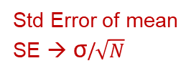
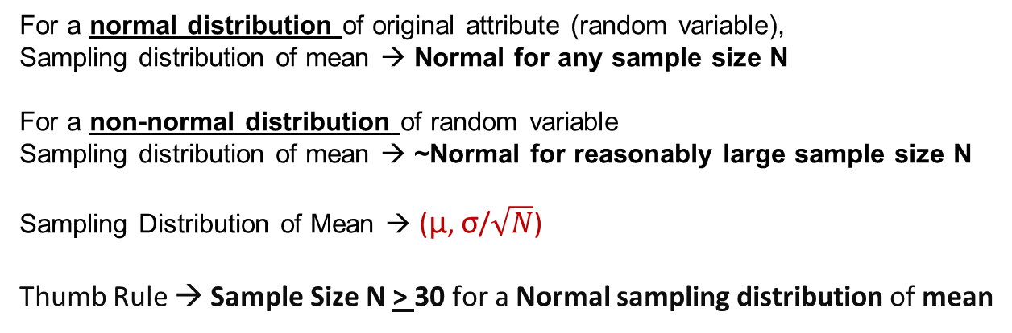
Sampling Distribution
Population
Population Parameters
(µ, σ) for a population attribute
(random variable)
Sample N
Sample1
Sample2
Sample i
X_{N}
Sample Statistic →
X₁
X₂
X_{i}
Frequency Distribution of Sample Mean
→ Called Sampling Distribution
→ Normal Distribution (for sufficiently large N)
For a normal distribution of original attribute (random variable),
Sampling distribution of mean → Normal for any sample size N
For a non-normal distribution of random variable
Sampling distribution of mean → ~Normal for reasonably large sample size N
Sampling Distribution of Mean → (µ, σ/$\sqrt{N}$)
Thumb Rule → Sample Size N > 30 for a Normal sampling distribution of mean
Freq
(or Prob)
X → µ
Std Error of mean
SE → σ/$\sqrt{N}$
Sample Mean
X_{i}

Slide 5
Central Limit Theorem
“Sampling Distribution of the mean of any independent random variable will be normal”
This applies to both discrete and continuous distributions.
The random variable should have a well defined mean and variance (standard deviation).
Applicable even when the original variable is not normally distributed.
Let’s watch central limit theorem in action with 3 different datasets
(please refer the notebook titled ‘Central Limit Theorem’)

Slide 6
Hypothesis
An assumption about certain characteristics of a population.
Null hypothesis (H0) -> The hypothesis that does not challenge the status quo
Alternative hypothesis(Ha) -> The hypothesis that challenges the status quo
Examples
“ Our population has gotten “significantly younger” → by atleast 3 yrs in the past 15 yrs”
“ Covid positivity rate is down by atleast ~40% in the past 6 months in Tamil Nadu”
“ The quality measures put in our plant 3 yrs ago has resulted in lower than 1% defects in parts”
“ Customer churn dropped to ~10% for Airtel in the past 1 year”
“Customer wait time across the 5 Subway franchises in the city are different”

Slide 7
Hypothesis Testing & Type 1&2 Errors
An Example to understand Error Types
Hypothesis Testing Objective: Maximize power of Covid detection thru an alternate rapid test procedure
with confidence level of 95% (α = 5%)
Random Sample used for rapid test validation is
from Covid tested population
Based on established Covid Testing Method: Ground Truth
Covid Detection In population | H₀ True = Not Covid infected (Should not reject) | H₀ False = Covid infected (Should reject)
Covid Test is +ve (Reject H₀) | Type I error (α) (False Positive cases) | Correct Decision (Test is positive for Covid Infected patient)
Covid Test is –ve (Fail to Reject H₀) | Correct decision (Test is negative for non-infected patient) | Type II error (β) (False Negative cases)
Confidence Level =
1 - α
New Rapid Covid Test to be
at 95% confidence level
New Rapid Test Proposed
New Rapid Covid Test to
maximize power
Power of Test =
1 - β
Minimize β while keeping α = 5%

Slide 8
Type I and Type II Errors
Type I Error:
Rejection of null hypothesis when it should not have been rejected.
Incorrectly rejecting the null hypothesis.
Type II Error:
Failure to reject the null hypothesis, when it should have been rejected.
Incorrectly not rejecting the null hypothesis.
Causes of Type I and Type II Errors:
By random chance, we may select a sample which is not representative of the population.
Sampling techniques may be flawed.
Assumptions in our null hypothesis may be flawed.
Decision/ Reality | H_{o} True (Should not reject) | H_{o} False (Should reject)
Reject H_{o} | Type I Error (α) | Correct Rejection (No error)
Fail to Reject H_{o} | Correct Decision (No error) | Type II Error (β)

Slide 9
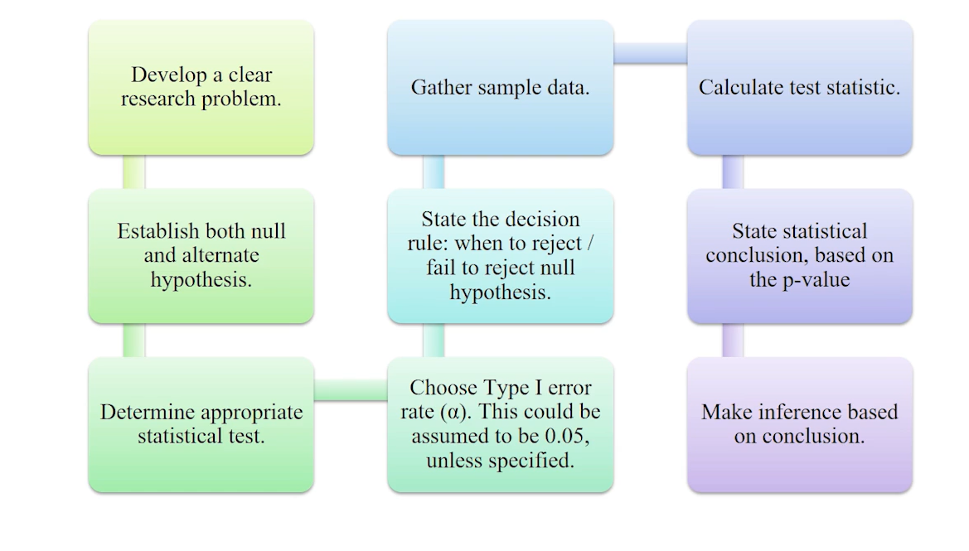
Hypothesis Testing Typical Process
Business
Context?
P-value?
Probability of the observed sample
statistic for the hypothesis test
“If p is low – null must go!”
What to prove / establish?

Slide 10
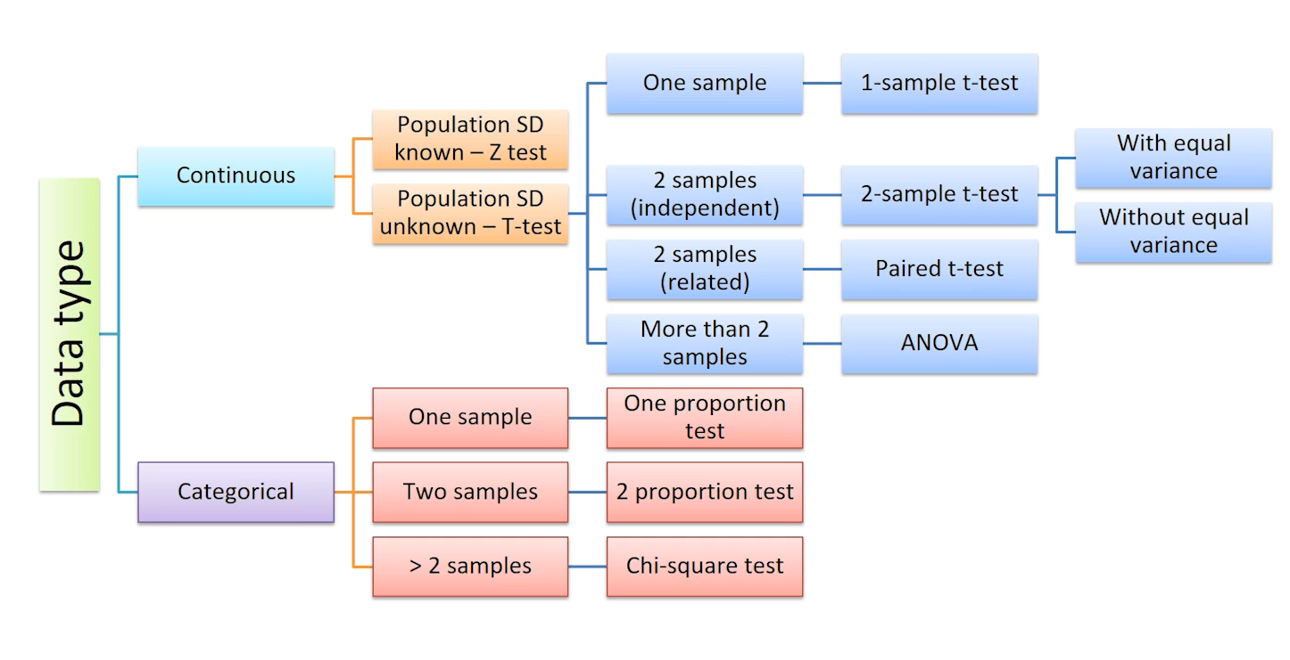
Hypothesis Testing Roadmap
POPULATION
SAMPLE
Single sample or two or multiple samples
One tailed or two tailed
Tests of Mean, Proportion, or Variance

Slide 11
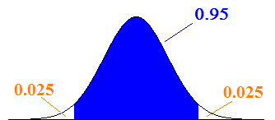
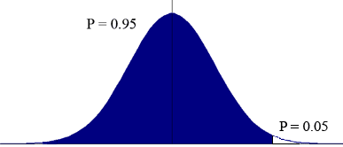
Confidence Intervals
95% of all sample means (x̅) are hypothesized to be in this region.
This is called as 95% confidence interval.
If sample mean is in the blue region, we fail to reject the null hypothesis
If sample mean is in the white region, we reject the null hypothesis.
Here, α = 0.05
α is the level of significance or our tolerance level towards making a Type I error.
If the null hypothesis is correct, (α * 100)% of the sample means should lie in the rejection region.
In case of one-tailed situation:
All of α is in one tail or the other, depending on the alternative hypothesis.
H_{a} points to the tail, where the critical value and the rejection region are.
(Case when observed mean > hypothesized mean)
Critical Value

Slide 12
Go to Case study Set1 for practice

Slide 13
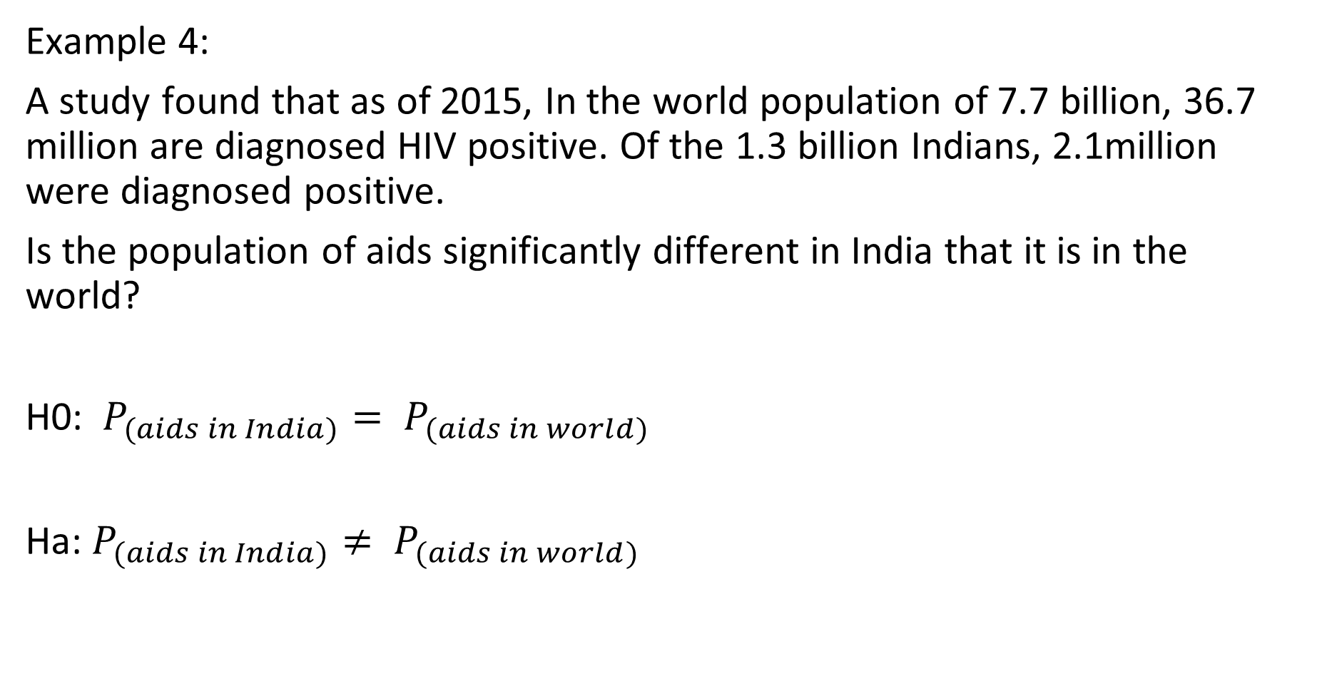
Z-Test for Proportions Example 1: AIDS in India vs World

Slide 14
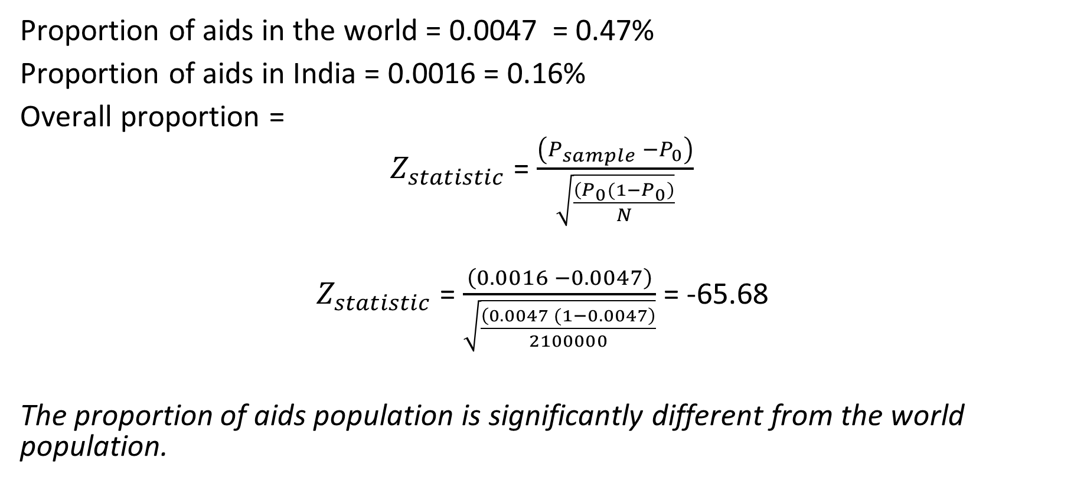
Solution:

Slide 15
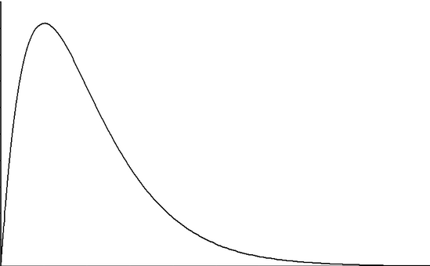
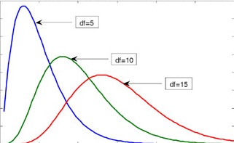
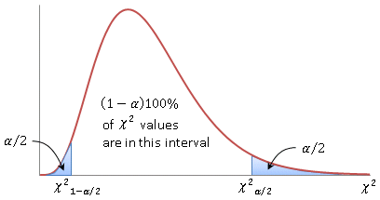
Chi square test of variance
When we take many samples of the same size from a normal population and find the sample means, they follow a normal distribution.
When we take many samples of the same size from a normal population and find the sample variances, they DO NOT follow a normal distribution; instead they follow a chi-square (χ²) distribution , which is dependent on the degrees of freedom.
Area under the curve is always 1.
Cumulative Probability runs from right to left; 1 is towards the left end, while 0 is towards the right.

Slide 16
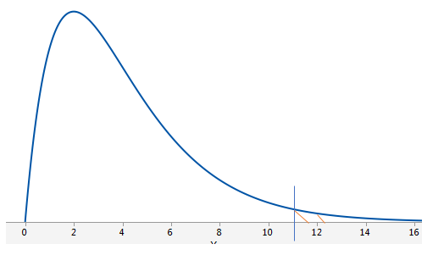
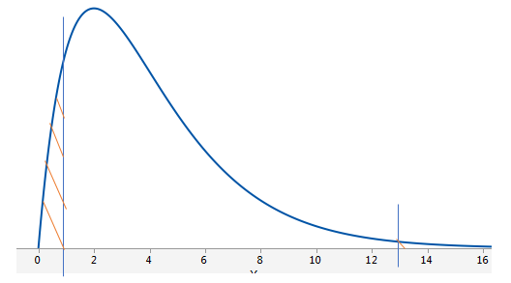
Chi square test of variance
Chi-square (χ²) test compares the population variance, with the hypothesized variance.
χ² = (n-1) s² where, n = sample size
σ² s² = sample variance and σ² = population variance (which we wish to test)
At α = 0.05 and n = 5 (df = 4)
p-value: How much of the area is above the test-statistic? (Does test statistic fall in the rejection region?)
If it is less than the specific α, we reject the null hypothesis

Slide 17
Example 2: Income Variance
The following is the income data of blue collar workers who are at the same skill level. There are two groups of workers. Workers of the textile company “Lori’s and Co.” and workers of the general population. We want to check weather the variance in the income of Lori’s is higher than of the general population.
Mean and variance of general population = 100, 16.11
Lori’s : 105, 95, 90, 98, 110, 104, 108, 111, 110, 102, 98, 105, 105, 105, 115
What are the null and alternative hypothesis?
Is it a right tailed or a left tailed test?
Is it a test of mean, proportion or variance?
Which statistical test do you think is appropriate?

Slide 18
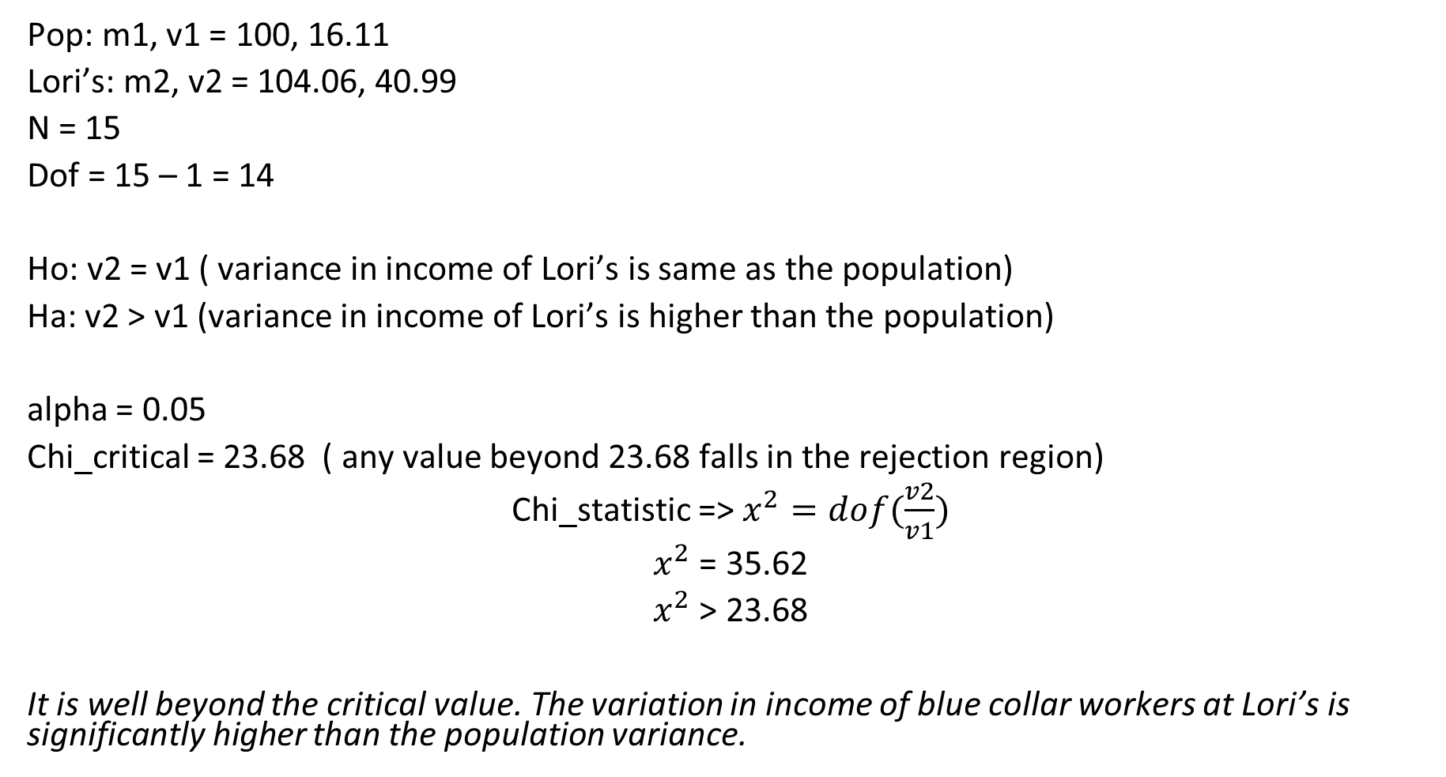
Example 2: Income Variance (contd.)

Slide 19
Hypothesis of One-Way ANOVA
H₀ : µ₁ = µ₂ = µ₃ = µ₄ = …= µ_{k}
All population means are equal
H_{a} : Not all of the population means are equal
For at least one pair, the population means are unequal.

Slide 20
One way ANOVA:
The one-way analysis of variance (ANOVA) is used to determine whether there are any statistically significant differences between the means of two or more independent (unrelated) groups
For one-way ANOVA, the ratio of the between-group variability to the within-group variability follows an F-distribution when the null hypothesis is true. When you perform a one-way ANOVA for a single study, you obtain a single F-value

Slide 21
Example 3 : Factory Emissions (ANOVA)
Three groups of samples of factory emissions of different plants of the same company were collected. The score is computed based on the composition of the emissions. We want to find out if there is any inconsistency or difference across the three groups.
A = 57,56,58,58,56,59,56,55,53,54,53,42,44,34,54,54,34,64,84,24
B = 49,47,49,47,49,47,49,46,45,46,41,42,41,42,42,42,14,14,34
C = 49,48,46,46,49,46,45,55,61,45,45,45,49,54,44,74,54,84,39

Slide 22
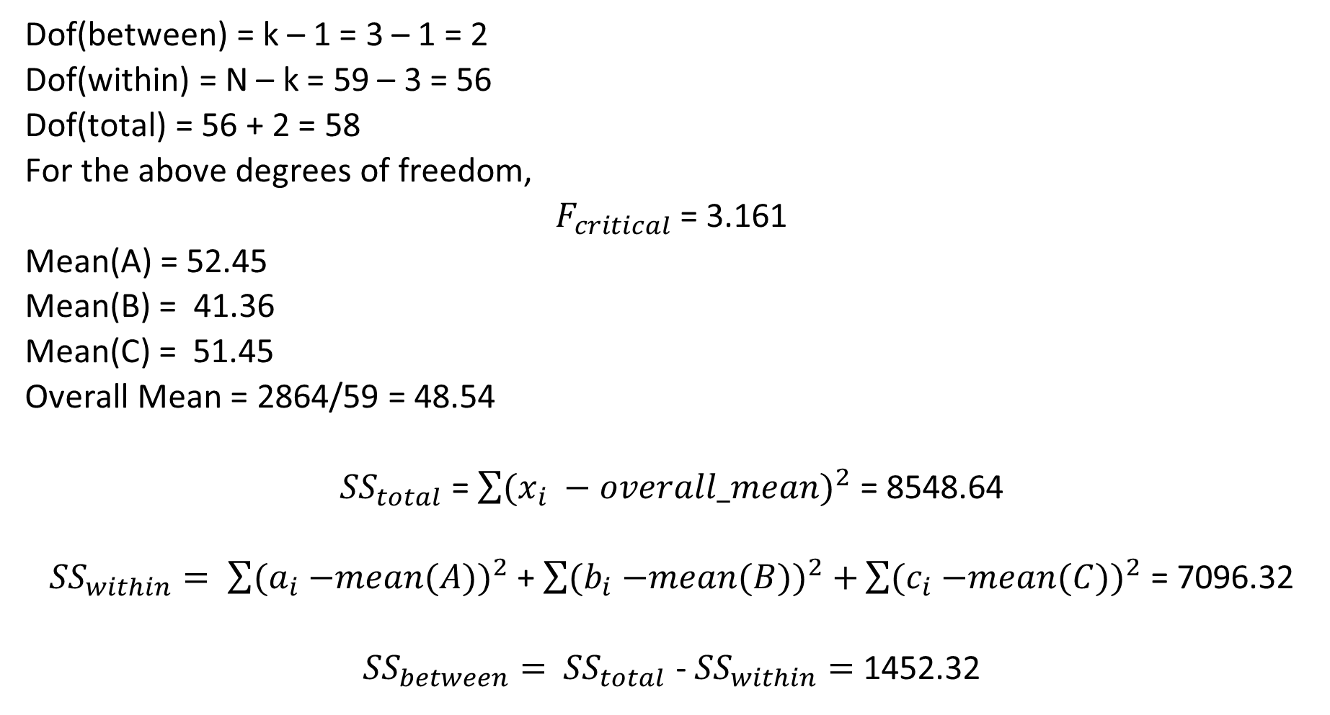
Example 3 : Factory Emissions (contd.)

Slide 23
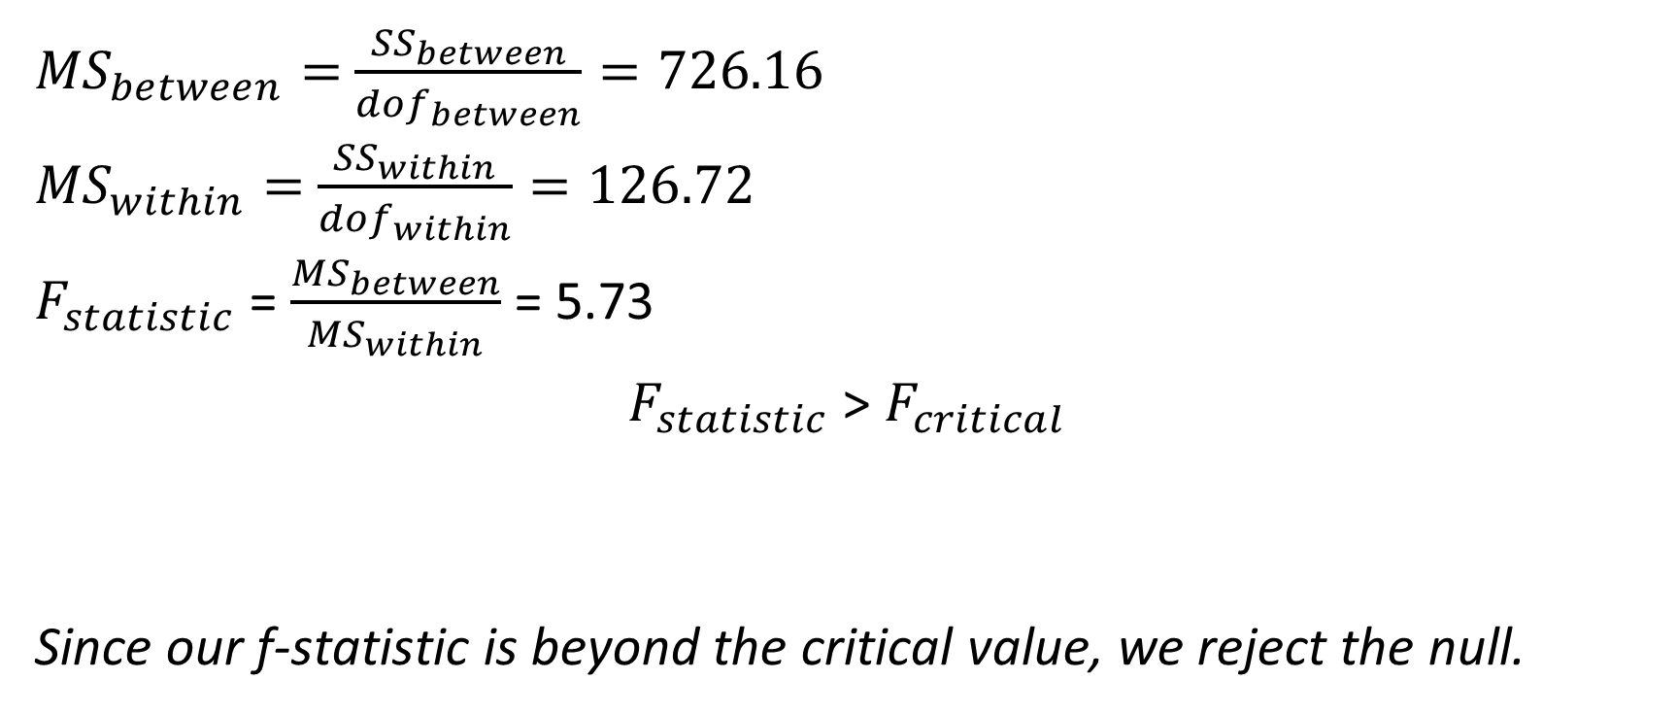
Example 3 : Factory Emissions (contd.)

Slide 24
Case Studies:
Z-test to compare means
One sample t-test
Two sample t-test (paired)
Paired sample t-test
Z-test and Chisquare_test for proportions
One-Way ANOVA
Datasets: Tech Crunch Dataset, Dogs as Pets, Forest Acorns, Medical Insurance, Factory Emissions

Slide 25
Few References for Hypothesis Testing
https://machinelearningmastery.com/statistical-hypothesis-tests/
https://towardsdatascience.com/hypothesis-testing-in-machine-learning-using-python-a0dc89e169ce
https://towardsdatascience.com/understanding-the-normal-distribution-with-python-e70bb855b027
https://www.tutorialspoint.com/python_data_science/python_normal_distribution.htm

Slide 26


Questions?

